Slide 1
Numbers of Water Intake effect on the Hours of concentration on Homework
Pa Yang

Slide 2
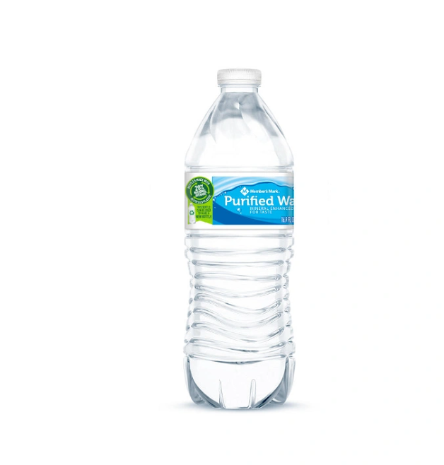
Introduction
Research stated that the more water you drink the more productive you are
Interested in seeing if water have an effect of how productive I am everyday
Background
Don’t drink much water
I work part time Monday,Tuesday,Thursday,Friday
Question: Is there a significant linear relationship between the numbers of water of intake and the concentration hours of doing homework?
Null hypothesis (H0): There is no significant relationship between the numbers of water intake and the concentration hours of doing homework(beta=0)
Hypothesis (Ha): There is a significant relationship between the numbers of water intake and the concentration hours of doing homework (beta!=0)
Data Process
Numbers of water Intake: Count the numbers of water bottle I drink Per day
Hours of Homework: Count the numbers of hours I spend on that day doing Homework

Slide 3
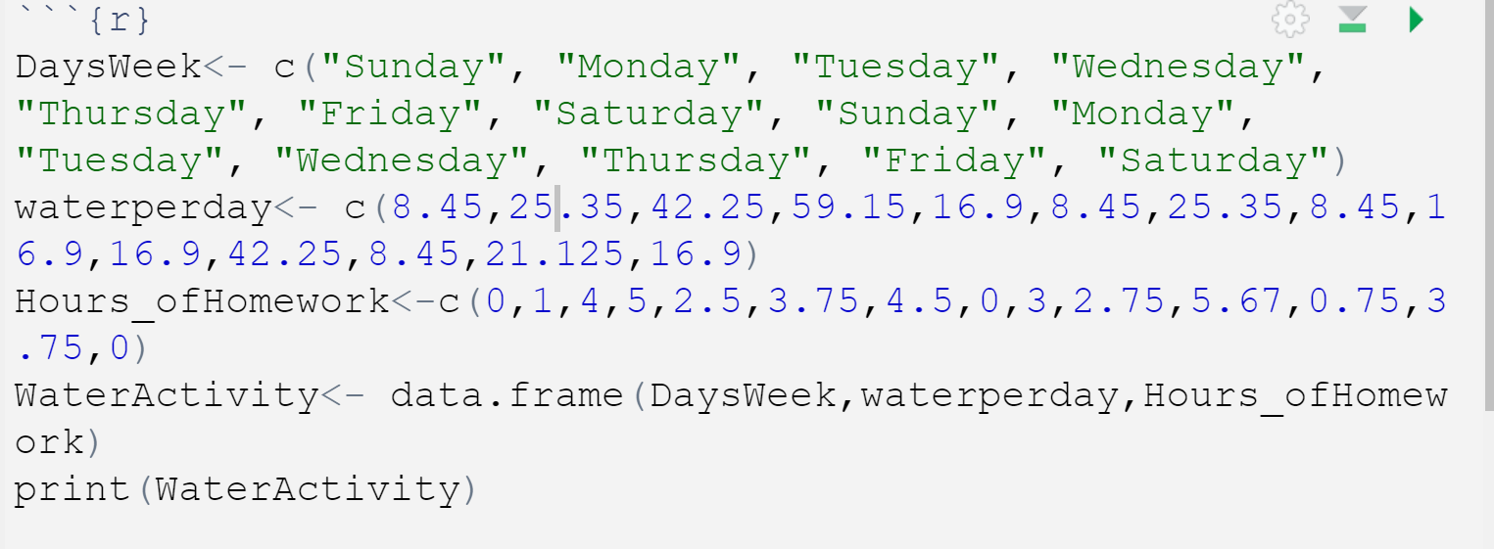
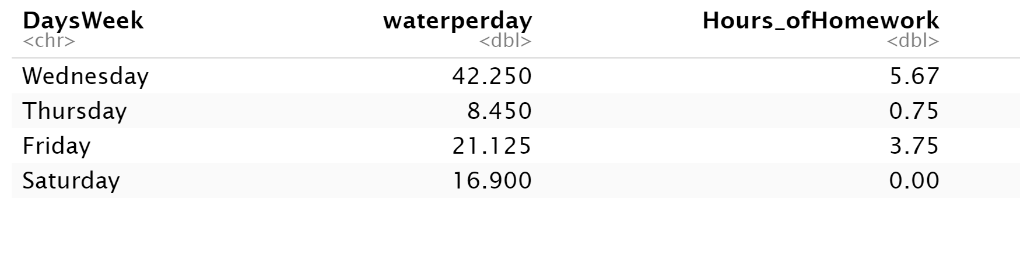
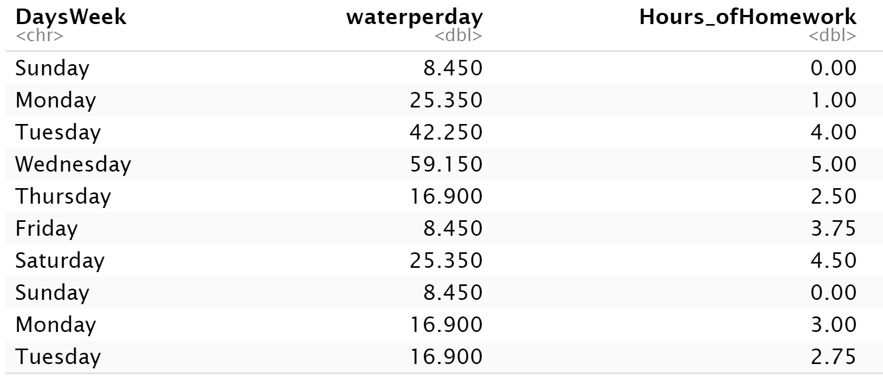
Code:

Slide 4
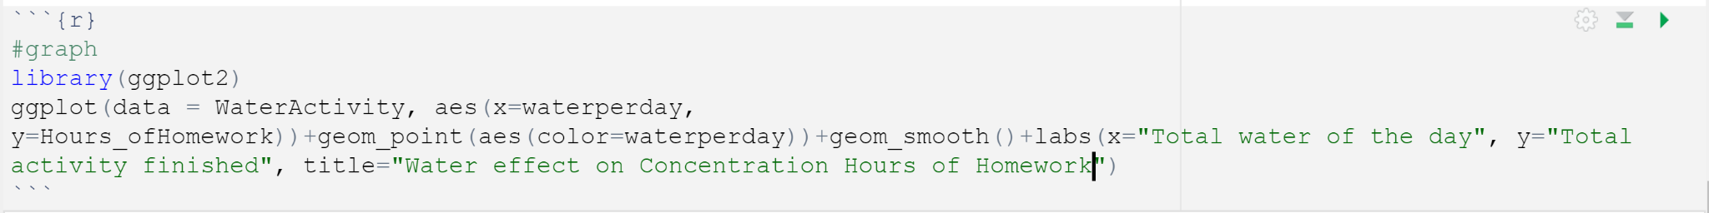
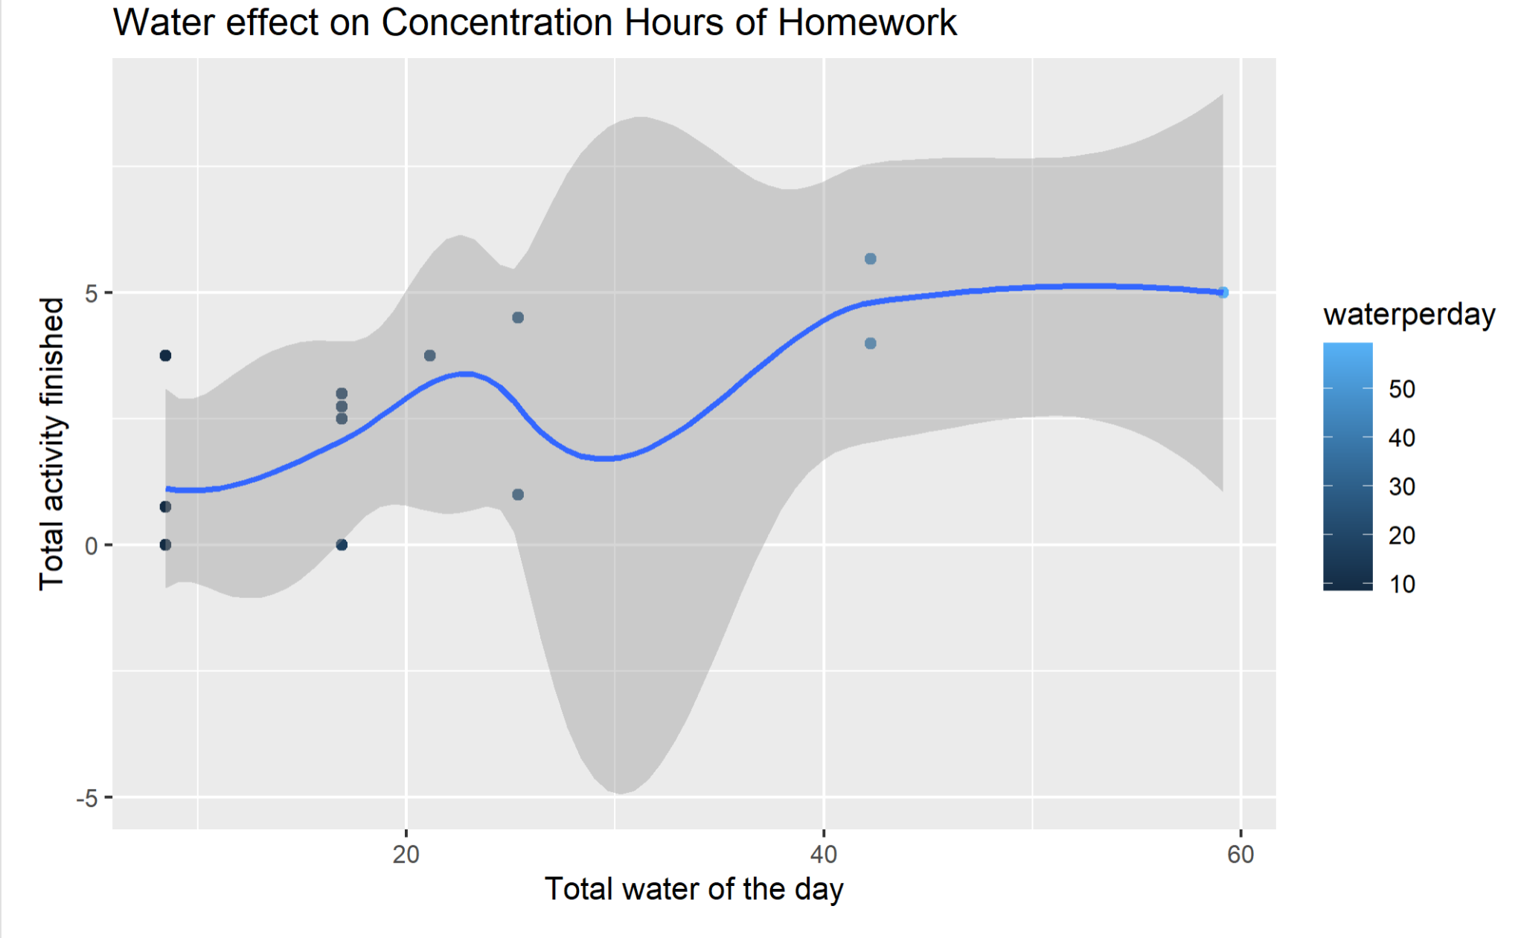
Visualization

Slide 5
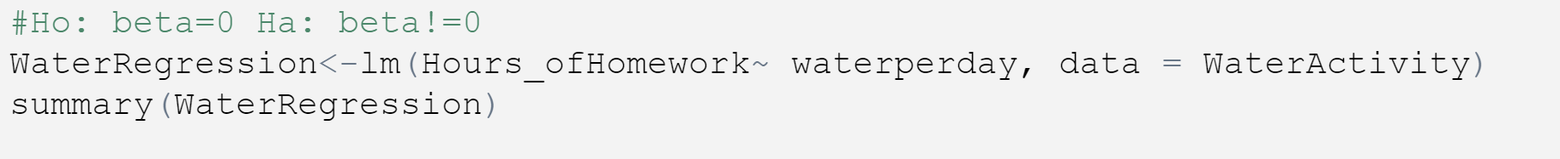
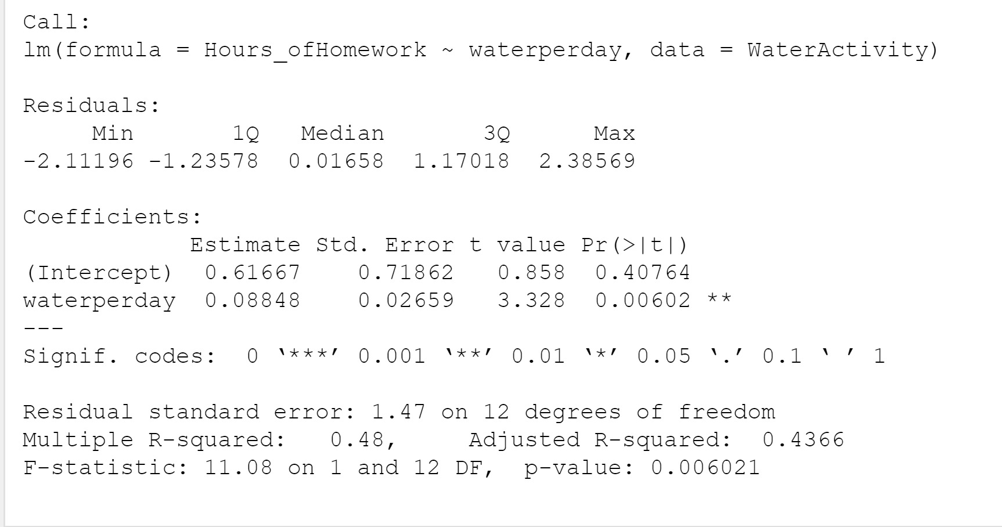
Linear Regression test

Slide 6
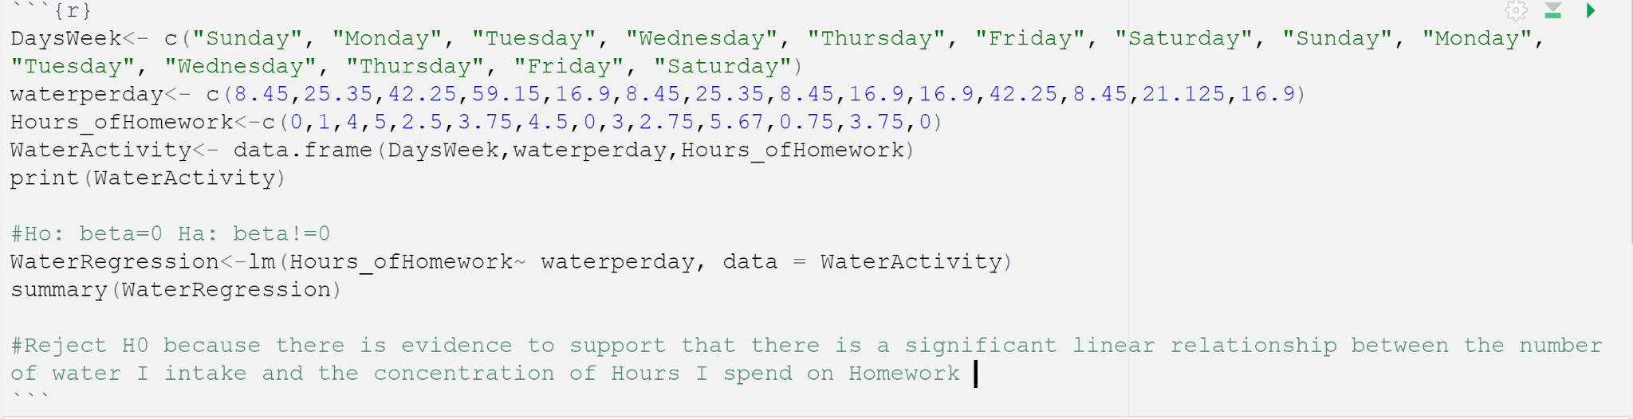
Conclusion:

Slide 7
QUESTION?

